Slide 1
AES Algorithm

Slide 2
Advanced Encryption Standard
Adopted by National Institute of Standards and Technology (NIST) on May 26, 2002.
AES is a simple design, a high speed algorithm, with low memory costs.
AES is a symmetric block cipher.
  The same key is used to encrypt and decrypt the message.
  The plain text and the cipher text are the same size.

Slide 3
AES Block
AES has a fixed block size of 128 bits called a state
ABCDEFGHIJKLMNOP
    A E I M 41 45 49 4D
    B F J N 42 46 4A 4E
    C G K O 43 47 4B 4F
    D H L P 44 48 4C 50
(ASCII)

Slide 4
AES Key
AES key is either 128 bits, 192 bits or 256 bits
128 bits (4 words):
11223344556677889900AABBCCDDEEFF
11 22 33 44
55 66 77 88
99 00 AA BB
CC DD EE FF

Slide 5
AES Key
or 192 bits (6 words)
1122334455667788
9900AABBCCDDEEFF
1122334455667788
11 22 33 44
55 66 77 88
99 00 AA BB
CC DD EE FF
11 22 33 44
55 66 77 88
or 256 bits (8 words)
1122334455667788
9900AABBCCDDEEFF
1122334455667788
9900AABBCCDDEEFF
11 22 33 44
55 66 77 88
99 00 AA BB
CC DD EE FF
11 22 33 44
55 66 77 88
99 00 AA BB
CC DD EE FF

Slide 6
Security
The key security feature is the size of the key.
Assuming that one could build a machine that could recover a DES key in a second (i.e., try 2⁵⁵ keys per second), then it would take that machine approximately 149 thousand-billion (149 trillion) years to crack a 128-bit AES key. To put that into perspective, the universe is believed to be less than 20 billion years old.
Accepting Moore's Law, doubling processor speed every 18 months, AES will be secure for another 109.5 years.

Slide 7
AES Algorithm Key Expansion
  Sample Key:
11223344556677889900AABBCCDDEEFF
The first 4 (N_{k}) words are set equal to the key
w[0] 11 22 33 44
w[1] 55 66 77 88
w[2] 99 00 AA BB
w[3] CC DD EE FF

Slide 8
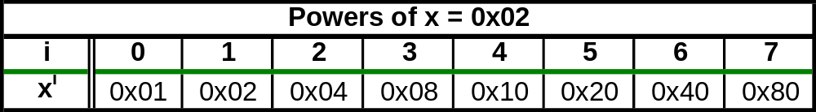
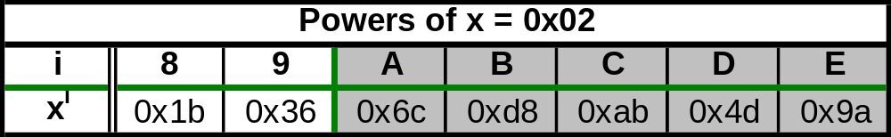
rCon – round Constants
rCon can be implemented with a look-up-table
2^{i} in GF(2⁸)
Removes symmetry and linearity from key expansion.

Slide 9
AES Algorithm Key Expansion
  For words 4 through 43
  i = N_{k} // N_{k} = 4
  while (i < N_{b}*(N_{r}+1)) {// N_{b}*(N_{r}+1)= 4*(10+1)= 44
  temp = W[i-1]
  If (i%N_{k} == 0)
  rotate word left 1 byte
  process each byte through sbox
  XOR with RCON[i] // just first element of w
  w[i] = w[i-4] XOR temp
  i++}
i = 4
  temp = C0 28 16 4B
w[i] = w[i-4] XOR temp

Slide 10
AES Algorithm
Key Expansion
w[0] 11 22 33 44
w[1] 55 66 77 88
w[2] 99 00 AA BB
w[3] CC DD EE FF
w[4] D1 0A 25 0F
i = 4 temp = C0 28 16 4B w[i] = w[i-4] XOR temp
w[4] = (11 C0) (22 28) (33 16) (44 4B)
w[4] = D1 0A 25 0F

Slide 11
AES Algorithm Key Expansion
  For words 4 through 43
  i = N_{k} // Nk = 4 i = 5
  while (i < N_{b}*(N_{r}+1)) { // N_{b}*(N_{r}+1)= 4*(10+1)= 44 temp = w[i-1]
  If (i%N_{k} == 0)
  rotate word left 1 byte
  process each byte through sbox
  XOR with RCON[i/N_{k}-1] // just first element of W
  w[i] = w[i-4] XOR temp
  i++}
temp = w[4] = D1 0A 25 0F

Slide 12
AES Algorithm Key Expansion
w[0] 11 22 33 44
w[1] 55 66 77 88
w[2] 99 00 AA BB
w[3] CC DD EE FF
w[4] D1 0A 25 0F
i = 5 temp = D1 0A 25 0F w[i] = w[i-4] XOR temp
w[5] = (55 D1) (66 0A) (77 25) (88 0F)
w[5] = 84 C6 52 87

Slide 13
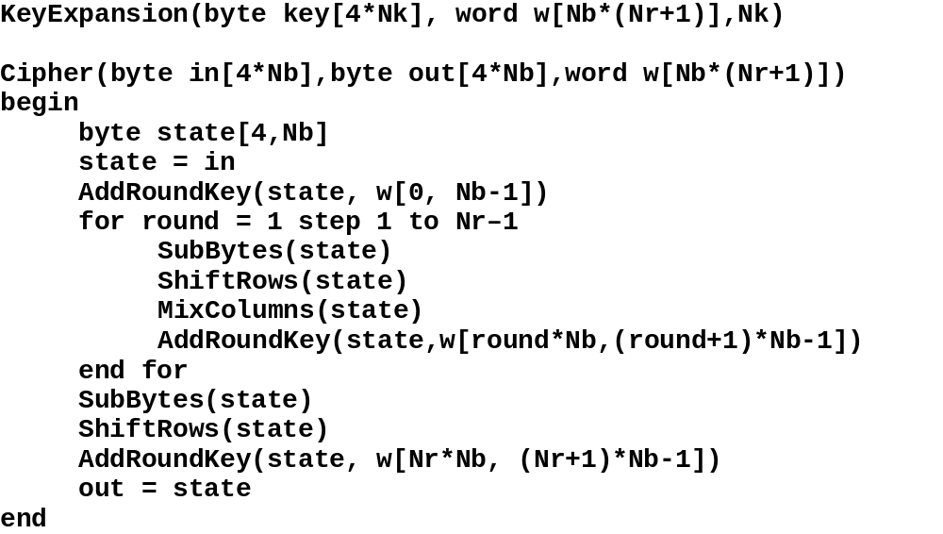
AES Algorithm

Slide 14
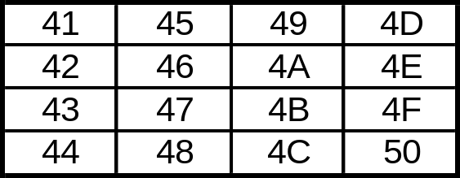
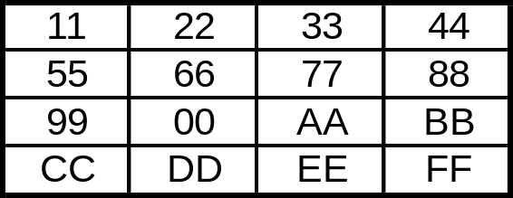
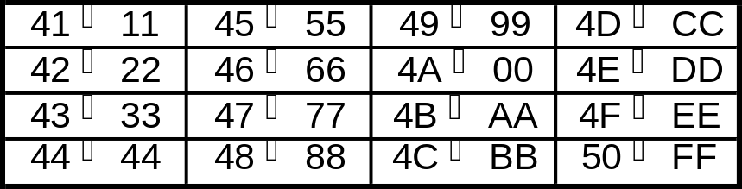
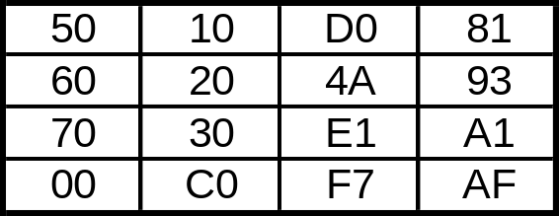
AES Algorithm
AddRoundKey
Expanded Key w[0] → w[4]
State
After AddRoundKey

Slide 15
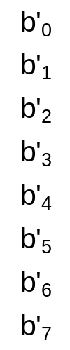

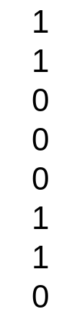
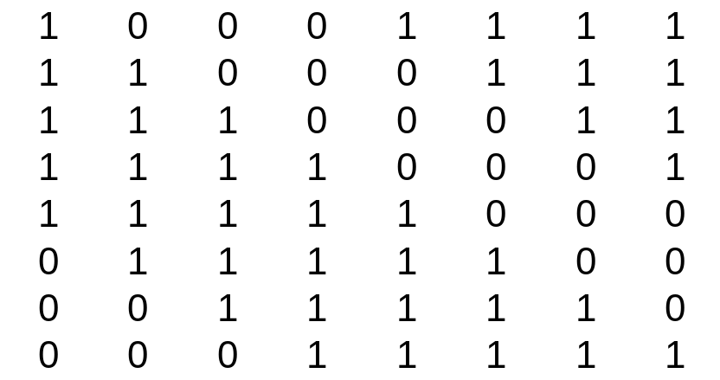
AES Algorithm
SubBytes
SubBytes is the SBOX for AES
This make AES a non-linear cryptographic system.
For every value of b there is a unique value for b’
  It is faster to use a substitution table (and easier).
=
+
x is the inverse value of the byte b

Slide 16
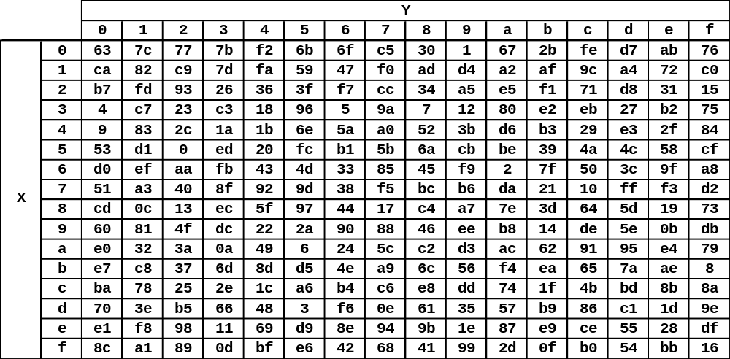
AES Algorithm
SubBytes

Slide 17
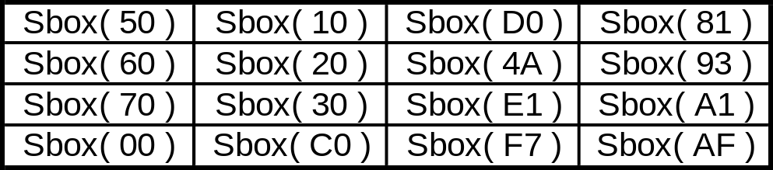
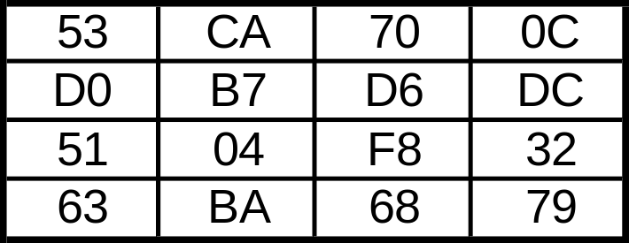
AES Algorithm
SubBytes
State

Slide 18
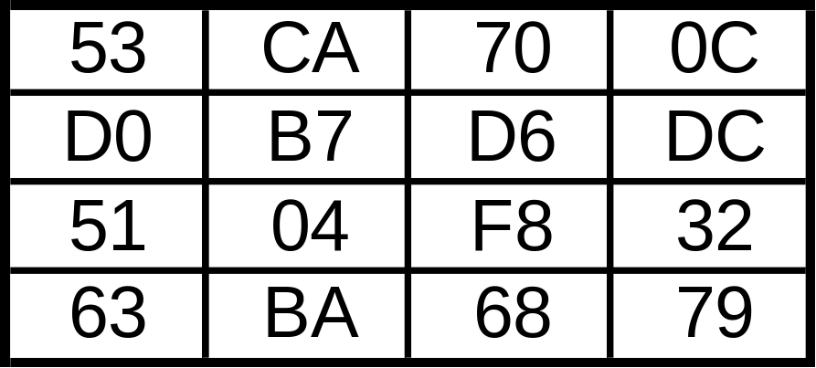
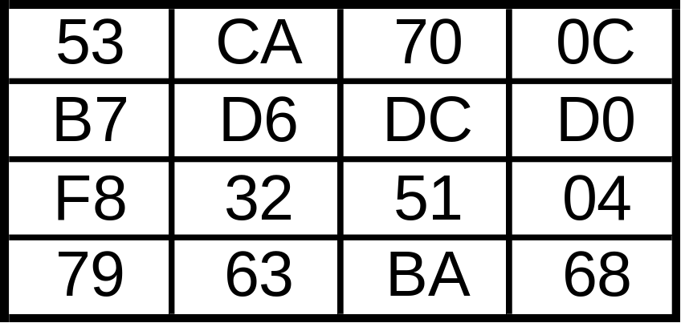
AES Algorithm
ShiftRows
Simple routine which performs a left shift rows 1, 2 and 3 by 1, 2 and 3 bytes respectively
Before Shift Rows
After Shift Rows

Slide 19
AES Algorithm - MixColumns
This with shift rows provides diffusion
The columns are considered polynomials over GF(2⁸) and multiplied modulo x⁴+1 with a(x) where a(x) = {03}x³ + {01}x² + {01}x + {02} NOTE: x⁴+1 is relatively prime to a(x)
a’_{j} ← (a_{j}*a(x))mod(x⁴+1)
This can also be written as matrix multiplication.
a’₀
a’₁
a’₂
a’₃
02 | 03 | 01 | 01
01 | 02 | 03 | 01
01 | 01 | 02 | 03
03 | 01 | 01 | 02
a₀
a₁
a₂
a₃
=

Slide 20
AES Algorithm - MixColumns
a’₀
a’₁
a’₂
a’₃
02 | 03 | 01 | 01
01 | 02 | 03 | 01
01 | 01 | 02 | 03
03 | 01 | 01 | 02
a₀
a₁
a₂
a₃
a’₀ = 2a₀ + 3a₁ + a₂ + a₃
a’₁ = a₀ + 2a₁ + 3a₂ + a₃
a’₂ = a₀ + a₁ + 2a₂ + 3a₃
a’₃ = 3a₀ + a₁ + a₂ + 2a₃
a’₀ = 2a₀  3a₁  a₂  a₃
a’₁ = a₀  2a₁  3a₂  a₃
a’₂ = a₀  a₁  2a₂  3a₃
a’₃ = 3a₀  a₁  a₂  2a₃
=
Addition is easy in GF(2⁸) : Addition is just the XOR operation
Multiplication by 1 is easy in GF(2⁸) : Multiplication by one is the identity
Multiplication by 2 in GF(2⁸) takes some work: . If multiplying by a value < 0x80 just shift all the bits left by 1 . If multiplying by a value ≥ 0x80 shift left by 1 and XOR with 0x1b . This prevents overflow and keeps the values within range
To Multiply by 3 in GF(2⁸) : a * 0x03 = a * (0x02 + 0x01) = (a * 0x02)  (a * 0x01)

Slide 21
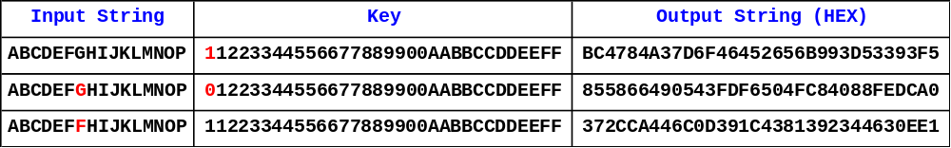
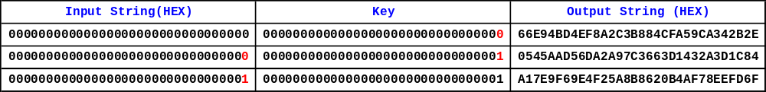
Sample Conversions

Slide 22
AES Algorithm
Encryption
Decryption
PlainText
Cipher Text
RoundKey
AddRoundKey
1st Round
RoundKey*
AddRoundKey
1st Round
SubBytes
InvShiftRows
ShiftRows
Repeat N_{r} -1 Round
InvSubBytes
Repeat N_{r} -1 Round
MixColumns
RoundKey*
AddRoundKey
RoundKey
AddRoundKey
InvMixColumns
SubBytes
InvShiftRows
ShiftRows
Last Round
InvSubBytes
Last Round
RoundKey
AddRoundKey
RoundKey*
AddRoundKey
CipherText
Plain Text
* RoundKey Added in reverse order

Slide 23
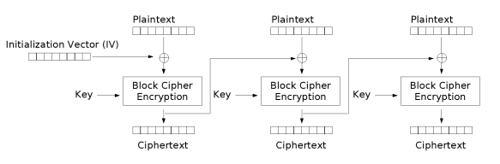
Larger Plain Texts
How to avoid frequency analysis?
Cipher Block Chaining

Slide 24
Padding
If plaintext messages are not divisible by 16 bytes. Padding may be a solution.
An easy method is to add a single 1 bit at the end of the message followed by enough 0’s to fill the block.
  If the block is filled, encode one more block with a 1 followed by 0’s.

Slide 25
Types of Side Channel Attacks
Timing Attacks – Watches movement of data in and out of the CPU or memory.
  It is difficult to retrieve an array element in a time that is not dependent on the index value.
Power Attacks – Watches power consumption by CPU or memory.
  Changing one bit requires considerably less power than changing all bits in a byte.

